Slide 1
Multimodal protein representation learning and target-aware variational auto-encoder for protein-binding ligand generation
Authors: Nhat Khang Ngo and Truong Son Hy
Publication: Machine Learning: Science and Technology, 2024

Slide 2
iNTRODUCTION
Drug discovery is a complex and expensive process that takes years of development and costs billions of dollars
Drug discovery process stages: Designing compounds, predicting affinities, clinical trials
Desing novel drug-like compounds with high binding affinities to target proteins
Searching for candidates
Measuring drug-target affinities
Current reliance on virtual screenings and expert evaluations
Limitations of molecular dynamics simulations: High computational cost, time-consuming -> infeasible for large-scale sets of protein-ligand complexes

Slide 3
Paper contribution
Develop a data-driven approach that can help accelerate the drug discovery process
Develop a conditional deep generative model to generate drug-like ligands that can bind to a target protein when its binding sites are unknown
TargetVAE: Generates ligands for arbitrary protein targets
PMN: Unifies different protein representations into a single, comprehensive model
Advantage: Does not require binding site information, making it more flexible and applicable

Slide 4
background
Proteins: macromolecules that can be represented in terms of
Sequences of amino acids
2D graphs at residue level constructed by nearest neighbors from folding information (i.e. tertiary structure)
3D point clouds at atom level
Protein representation: Importance of capturing both sequence and 3D structure
Variational Auto-Encoders: Framework for generating new data while maintaining desired properties
Protein-ligan binding prediction
ML methods, especially GNNs, have emerged as effective techniques for binding affinity prediction

Slide 5
Protein Multimodal Network (PMN)
Protein can be seen as long-range graphs, the authors used sequential and graph transformer to encode both sequences and 3D graphs of residues and combine them to create a unified representation for a large protein
Sequence Modeling: Uses a transformer-based language model to capture sequence information
Geometric Learning: MPNN captures 3D structure and residue interactions
Fusion: Integrates both sequence and geometric data for a holistic protein representation

Slide 6
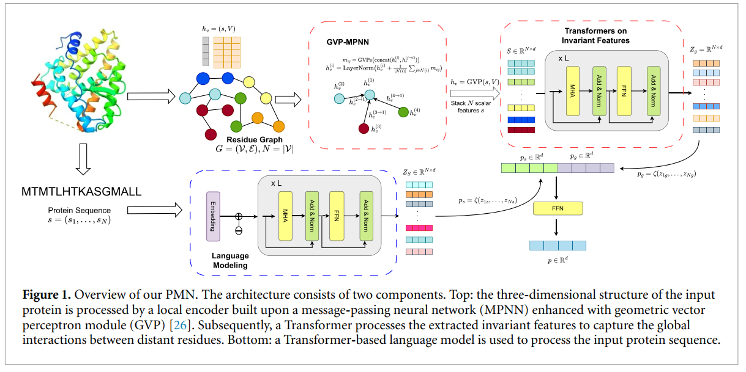
Protein Multimodal Network (PMN)

Slide 7
PMN Architecture
Local Encoder: Extracts rotationally invariant and equivariant features
Geometric vector perceptron (GVP)
Global Transformer Encoder: Captures interactions among distant residues.
Multi-modal Fusion: Produces a unified protein embedding.

Slide 8
Binding Affinity Prediction
Objective: Predict ligand binding strength to proteins.
Dataset: PDBBind v2020, split into training and testing sets.
Methodology: Combines PMN for proteins and GAT for ligands.
Training details: GVP for local features, GAT for ligand encoding, ESM-2 for sequences.
Evaluation metrics: RMSE, MAE, Pearson, Spearman, r2m scores.
Results: Superior performance of PMN, importance of multi-modal protein learning.

Slide 9
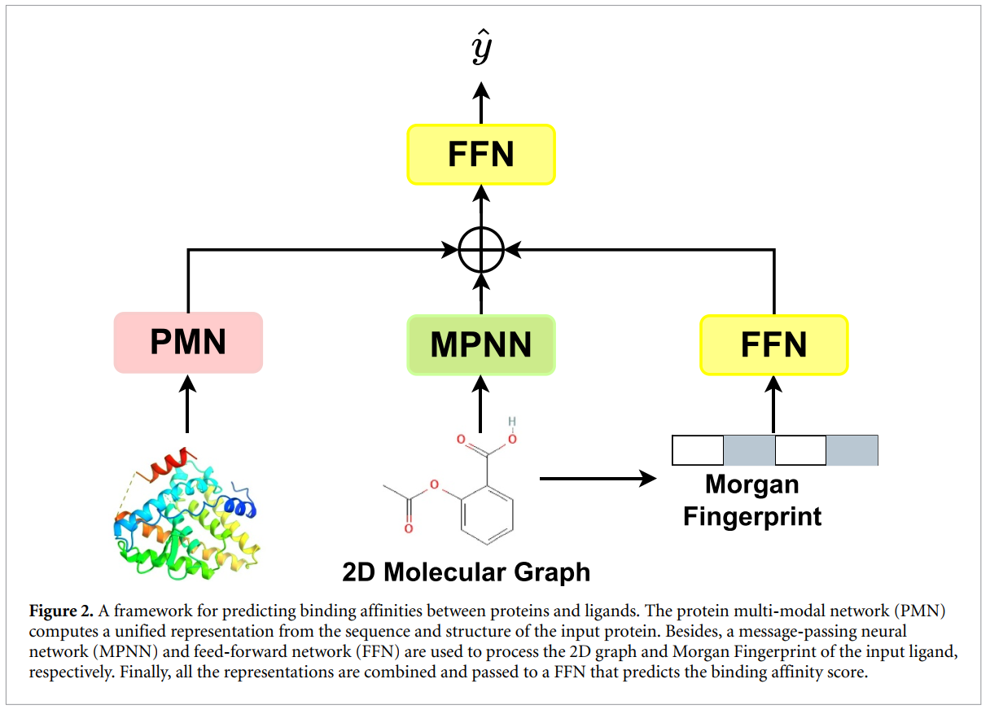
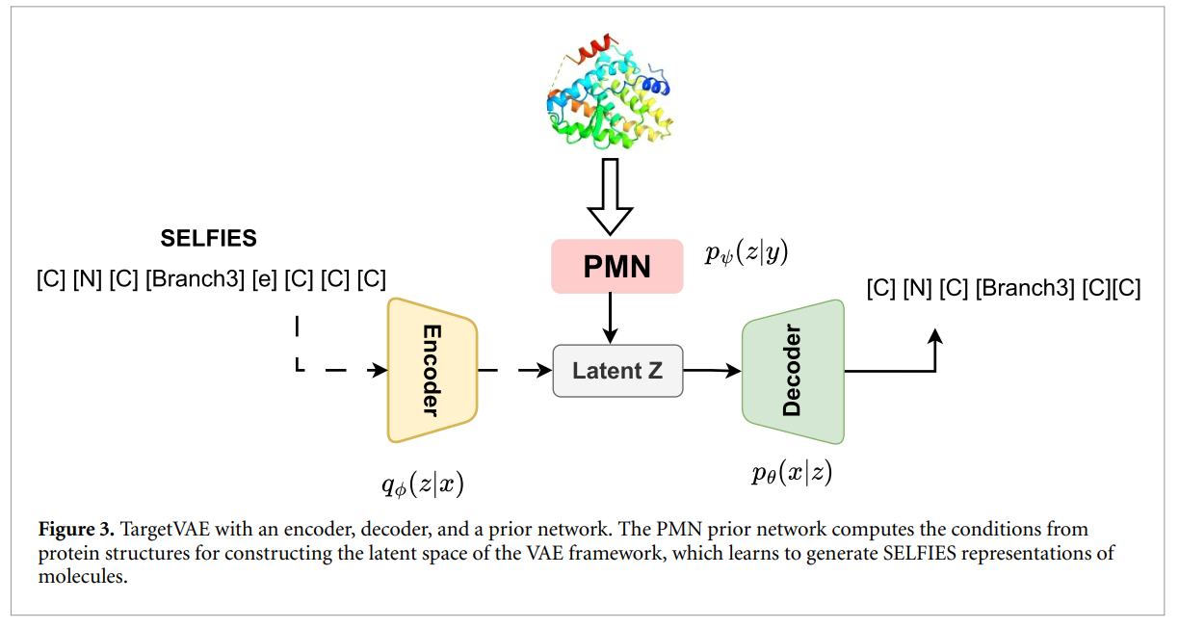
Experiment: Binding Affinity Prediction

Slide 10
Target-Aware Ligand Generation
Task: Generate ligands without known binding sites.
TargetVAE: Conditions on entire protein structure, generating multiple ligand candidates.
Benefits: Flexibility, efficiency in generating high-affinity ligands.
Setup: Generate 100 molecules per target, evaluated on binding affinity, QED, SA
Tools: AutoDock Vina for docking scores, RDKit for QED and SA
Results: High binding affinity, diverse binding poses

Slide 11
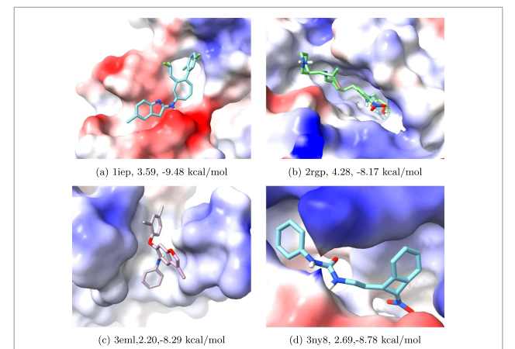
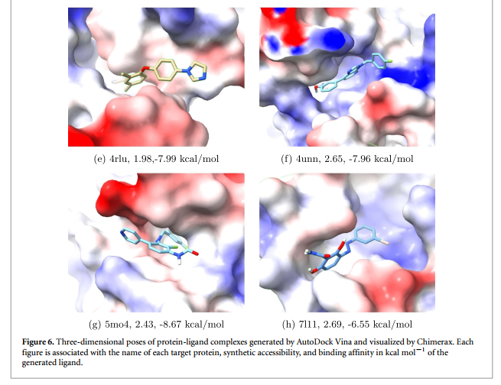
Experimental: Ligand Generation

Slide 12
Results
Visualization of ligand binding: Different poses for various targets
Demonstrates the effectiveness of PMN and TargetVAE in generating diverse and valid ligands
Binding affinity distributions: High affinity (low docking scores) for generated ligands
Average scores for top-ranked molecules: Binding Affinity, QED, SA
Trade-off: High binding affinity vs. other properties like drug-likeness

Slide 13
Conclusion
Key contributions: PMN for effective protein representation, TargetVAE for efficient ligand generation.
Advantages: Reduces need for specific networks, flexible, applicable in various drug discovery stages.
Future directions: Further validation through in vitro and in vivo experiments.

Slide 14
Thank you

